Slide 1
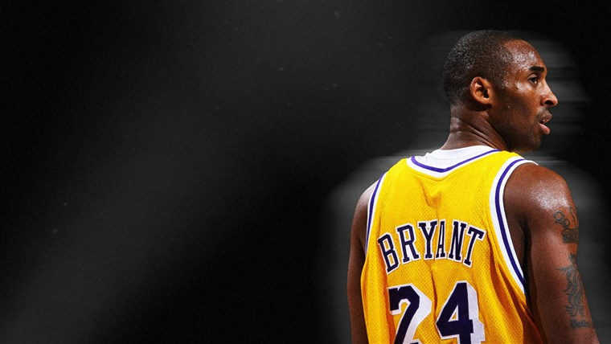
Kobe Bryant Shot
Selection
Kurt Doyle, Shiva Duddupudi,
Ruxin Li, Wade Strain

Slide 2
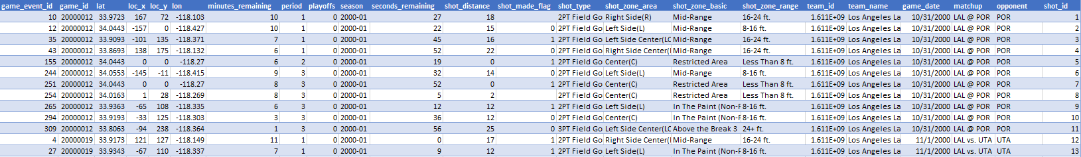
Kaggle Competition - Which Shots did Kobe Make?
Overview: The data contains the location and circumstances of every field goal attempted by Kobe Bryant during his 20-year career.
Objective: Binary Classification ; Given a held out test set, predict whether the basket went in.
Data: 25 variables
Type of shot, location information, time information, season information, etc. opponent information

Slide 3


Notebook Critique: SVM with Radial Kernel
Positive: Good use of augmenting the data. Created a time remaining column which combined two other columns.
Negative: Limited use of features (three of them), predicted actual class
Result: Kaggle Score 13.46328
https://www.kaggle.com/shuicaorj1036081/predict/code

Slide 4

Notebook Critique: XGBoost
Positive: Using approximate greedy algorithm when data is large, fits regression tree to residuals; Parallelization of tree construction using all of your CPU cores during training.
Negative: Easy overfitting and it is not good at extrapolating unseen values
Result: Kaggle Score 0.62363
https://www.kaggle.com/amineteffal/script-aminos-kb

Slide 5
Team Model Exploration
Model | Log Loss
XGBoost | 0.64997
SVM - Polynomial | 0.66780
SVC - Linear | 0.66797
Random Forest | 0.67752
Ensemble | 0.67970
50 / 50 Benchmark | 0.69314

Slide 6
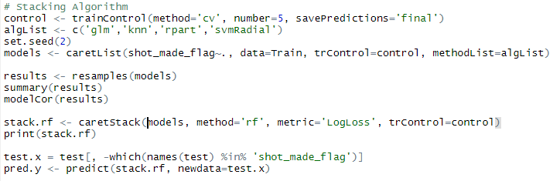
Team Model: Stacked Ensemble
Utilized 7 features
Used cross validation with five folds
4 different models: glm, knn, rpart, svm-radial
Measured model correlation to make sure the model were not too similar
Kaggle Score: 0.67970

Slide 7
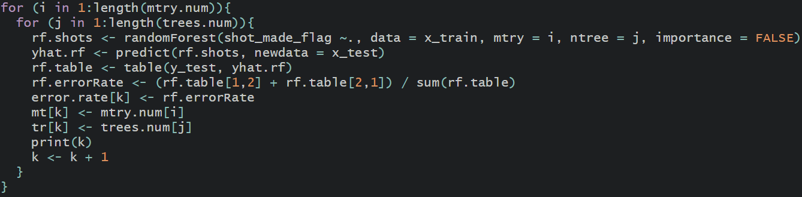
Team Model: Classification with Random Forest
Utilized 9 features
Varied mtry and ntrees values in a loop to calculate the overall error rate using random forest.
Best Results: mtry = 3 ; ntrees = 200 ; Kaggle Score: 0.67752

Slide 8
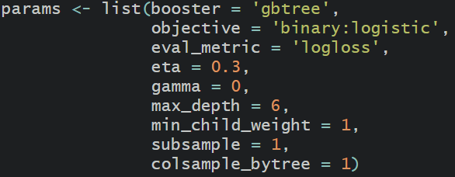
Team Model: XGBoost
Utilized 7 features
Used a gbtree booster while evaluating log loss, across several parameters
Kaggle Score: 0.64997

